Slide 1
Chapter 8 Alkenes: Reactions and Synthesis

Slide 2
Learning Objectives
(8.1)
Preparing alkenes: A preview of elimination reactions
(8.2)
Halogenation of alkenes: Addition of X₂
(8.3)
Halohydrins from alkenes: Addition of HOX
(8.4)
Hydration of alkenes: Addition of H₂O by oxymercuration
(8.5)
Hydration of alkenes: Addition of H₂O by hydroboration

Slide 3
Learning Objectives
(8.6)
Reduction of alkenes: Hydrogenation
(8.7)
Oxidation of alkenes: Epoxidation and hydroxylation
(8.8)
Oxidation of alkenes: Cleavage to carbonyl compounds
(8.9)
Addition of carbenes to alkenes: Cyclopropane synthesis
(8.10)
Radical additions to alkenes: Chain-growth polymers

Slide 4
Learning Objectives
(8.11)
Biological additions of radicals to alkenes
(8.12)
Reaction stereochemistry: Addition of H₂O to an achiral alkene
(8.13)
Reaction stereochemistry: Addition of H₂O to a chiral alkene

Slide 5
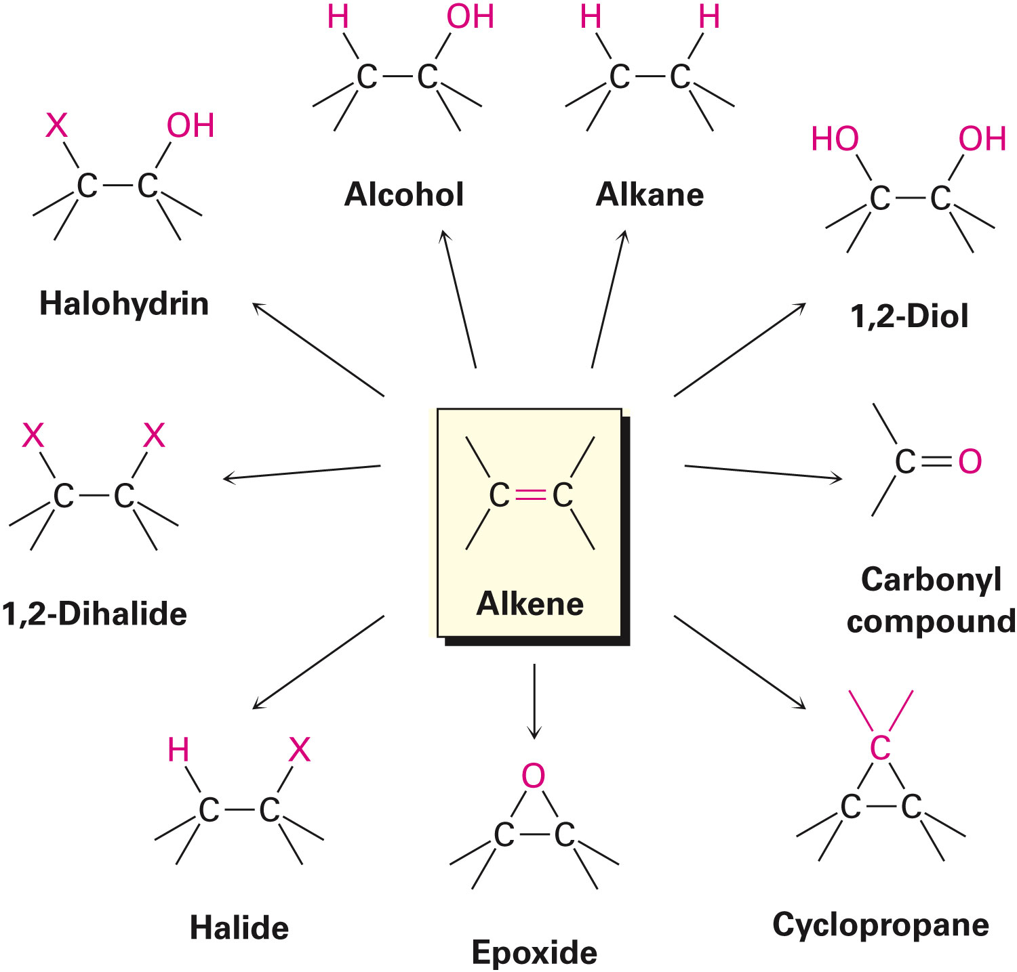
Diverse Reactions of Alkenes
Alkenes react with many electrophiles to give useful products by addition

Slide 6
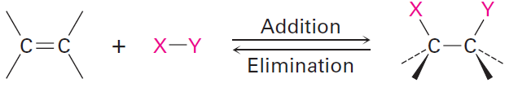
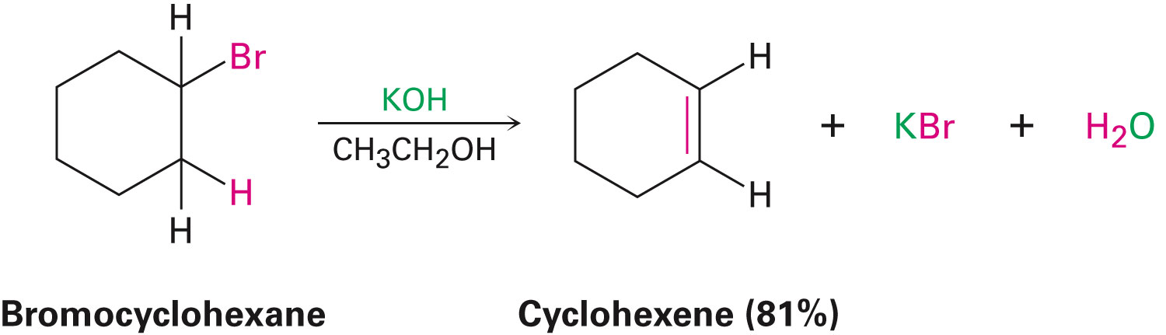
Preparation of Alkenes: A Preview of Elimination Reactions
Alkenes are commonly made by elimination reaction
Dehydrohalogenation - Loss of HX from an alkyl halide
Occurs by reaction of an alkyl halide with strong base
Notes:
Preparing Alkenes: A preview of elimination reactions

Slide 7
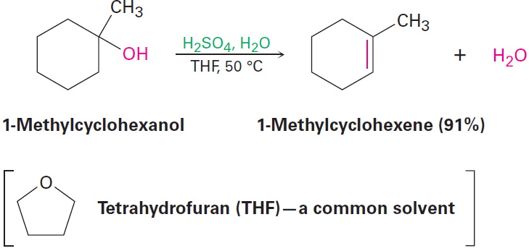
Preparation of Alkenes: A Preview of Elimination Reactions
Dehydration - Loss of water from an alcohol
Carried out by treating an alcohol with a strong acid
Notes:
Preparing Alkenes: A preview of elimination reactions

Slide 8
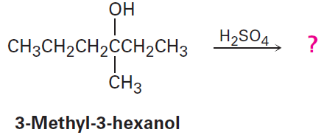
Worked Example
How many alkene products, including E,Z isomers, might be obtained by dehydration of 3-methyl-3-hexanol with aqueous sulfuric acid?
Notes:
Preparing Alkenes: A preview of elimination reactions

Slide 9
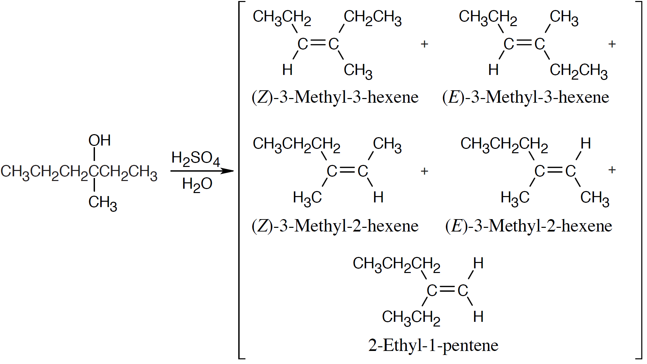
Worked Example
Solution:
It is possible to obtain five alkene products by the dehydration of 3-methyl-3-hexanol
Notes:
Preparing Alkenes: A preview of elimination reactions

Slide 10
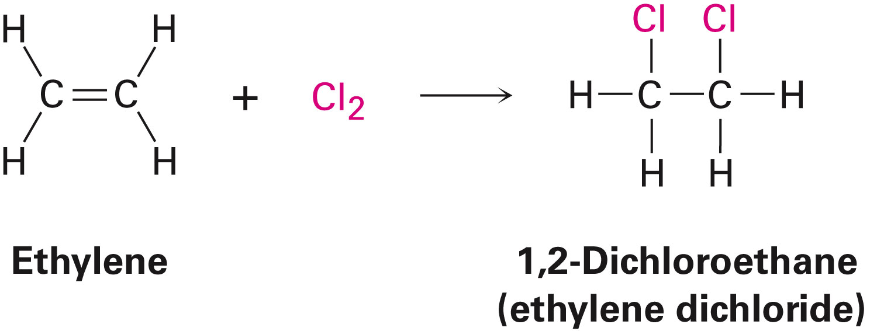
Halogenation of Alkenes: Addition of X₂
Halogenation - Bromine and chlorine add to alkenes to give 1,2-dihalides
Example
1,2-dichloroethane is formed by addition of Cl₂ to ethylene
Fluorine is too reactive and iodine does not react with majority of alkenes
Notes:
Halogenation of Alkenes: Addition of X₂

Slide 11
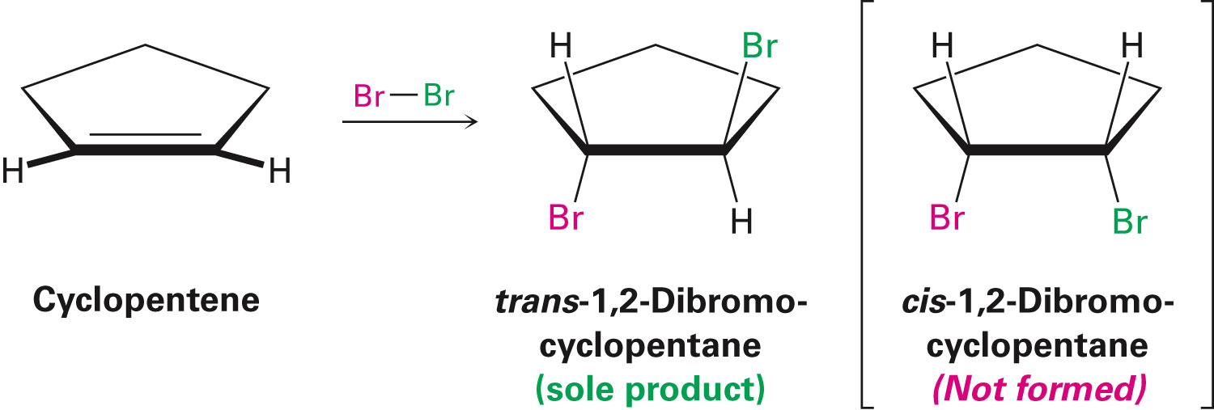
Halogenation of Alkenes: Addition of X₂
Halogenation reaction of cycloalkane forms the trans stereoisomer of the dihalide addition product
Reaction occurs with anti stereochemistry
Notes:
Halogenation of Alkenes: Addition of X₂

Slide 12
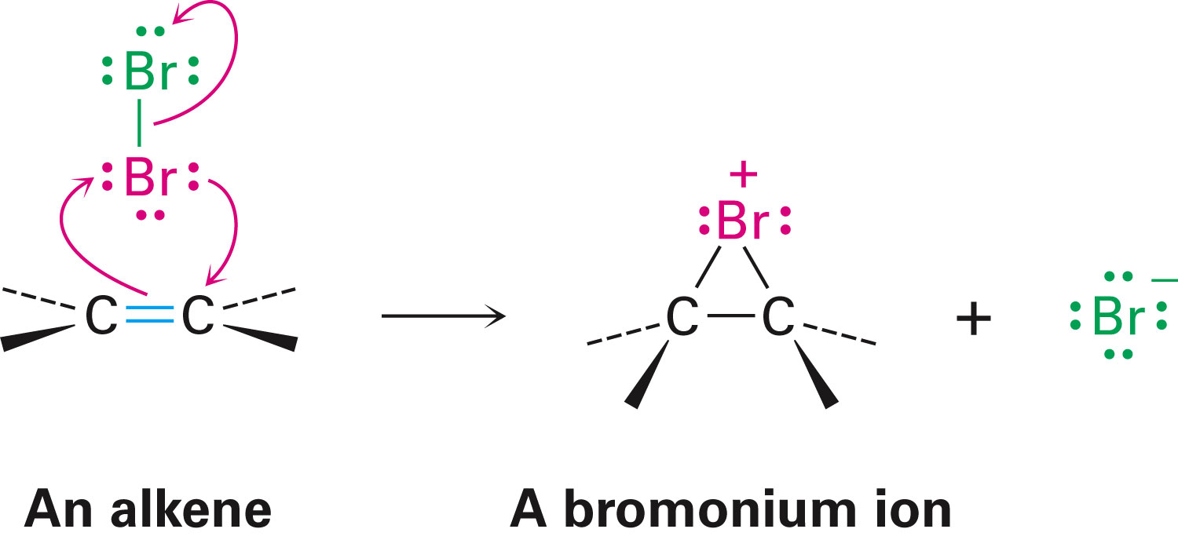
Mechanism of Bromine Addition
As suggested by George Kimball and Irving Roberts, for the observed stereochemistry the reaction intermediate is not a carbocation
Bromonium ion, R₂Br⁺, is formed by electrophilic addition of Br⁺ to the alkene
Notes:
Halogenation of Alkenes: Addition of X₂

Slide 13
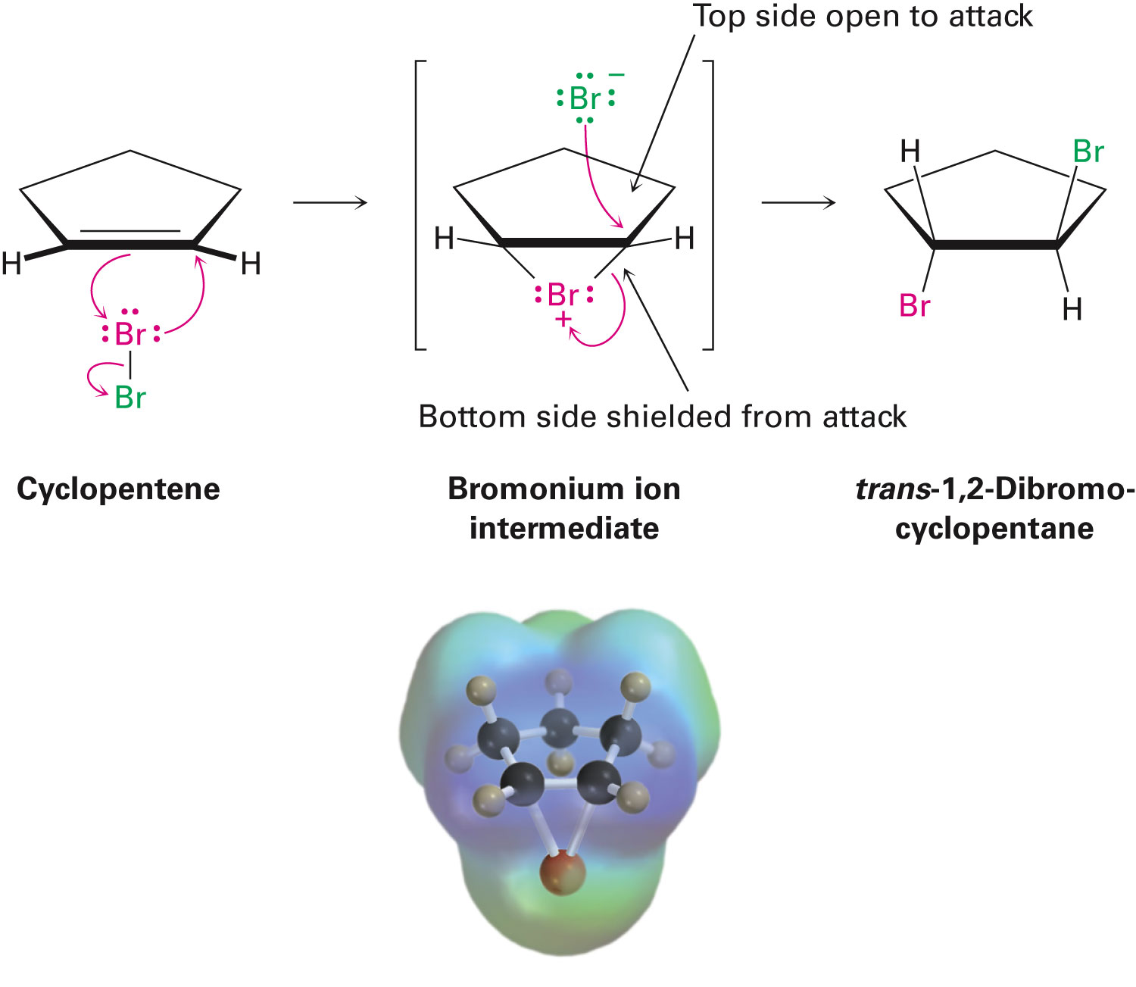
Mechanism of Bromine Addition
Bromonium ion is formed in a single step
Interaction of the alkene with Br₂ and simultaneous loss of Br⁻
Reaction with Br⁻ ion occurs only from the opposite, unshielded side to give trans product
Notes:
Halogenation of Alkenes: Addition of X₂

Slide 14
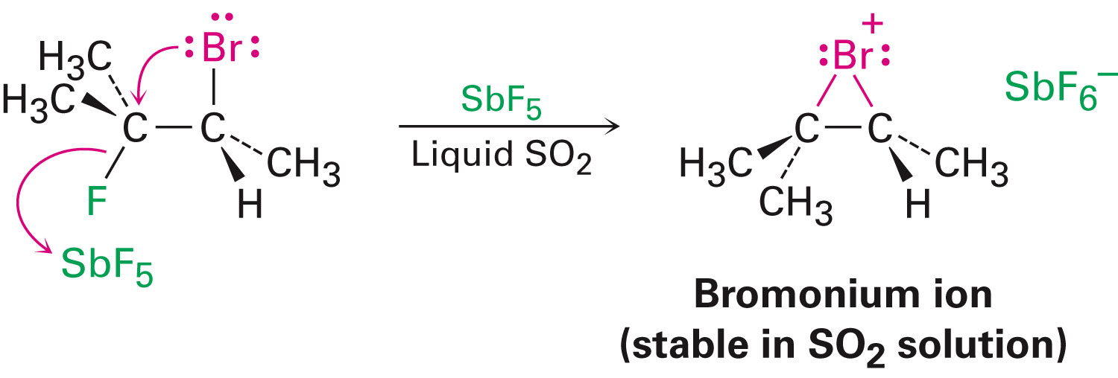
Mechanism of Bromine Addition
Bromonium ions were postulated more than 75 years ago to explain stereochemistry of halogen addition to alkenes
George Olah showed that bromonium ions are stable in liquid SO₂
Notes:
Halogenation of Alkenes: Addition of X₂

Slide 15
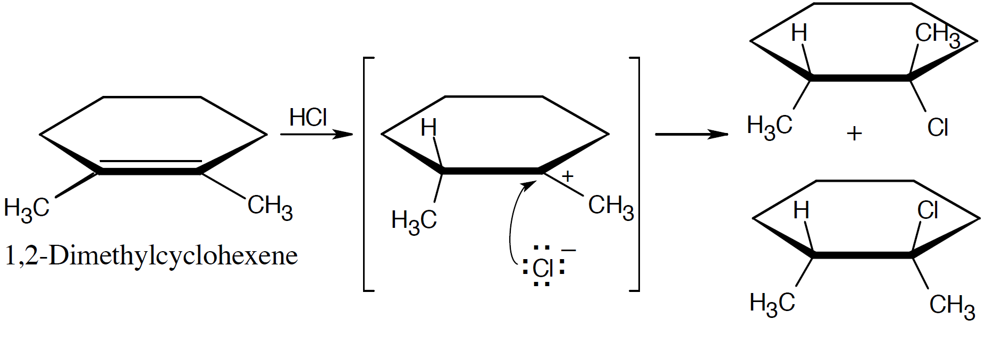
Worked Example
Addition of HCl to 1,2-dimethylcyclohexene yields a mixture of two products
Show the stereochemistry of each, and explain why a mixture is formed
Solution:
Addition of hydrogen halides involves formation of an open carbocation
Notes:
Halogenation of Alkenes: Addition of X₂

Slide 16
Worked Example
The carbocation, which is sp²-hybridized and planar, can be attacked by chloride from either top or bottom
This yields products in which the two methyl groups can be either cis or trans to each other
Notes:
Halogenation of Alkenes: Addition of X₂

Slide 17
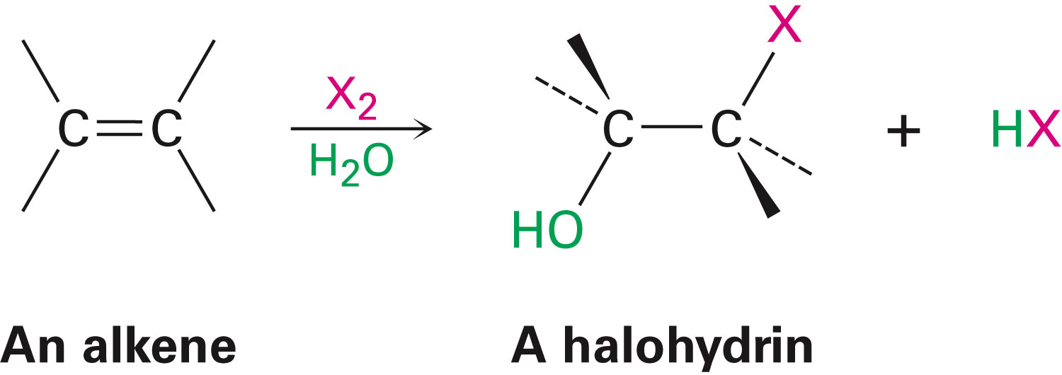
Halohydrins from Alkenes: Addition of HOX
Reaction of alkenes with hypohalous acids HO–Cl or HO–Br yields 1,2-halo alcohol, called a halohydrin
Addition takes place by reaction of the alkene with either Br₂ or Cl₂ in the presence of water
Notes:
Halohydrins from Alkenes: Addition of HOX

Slide 18
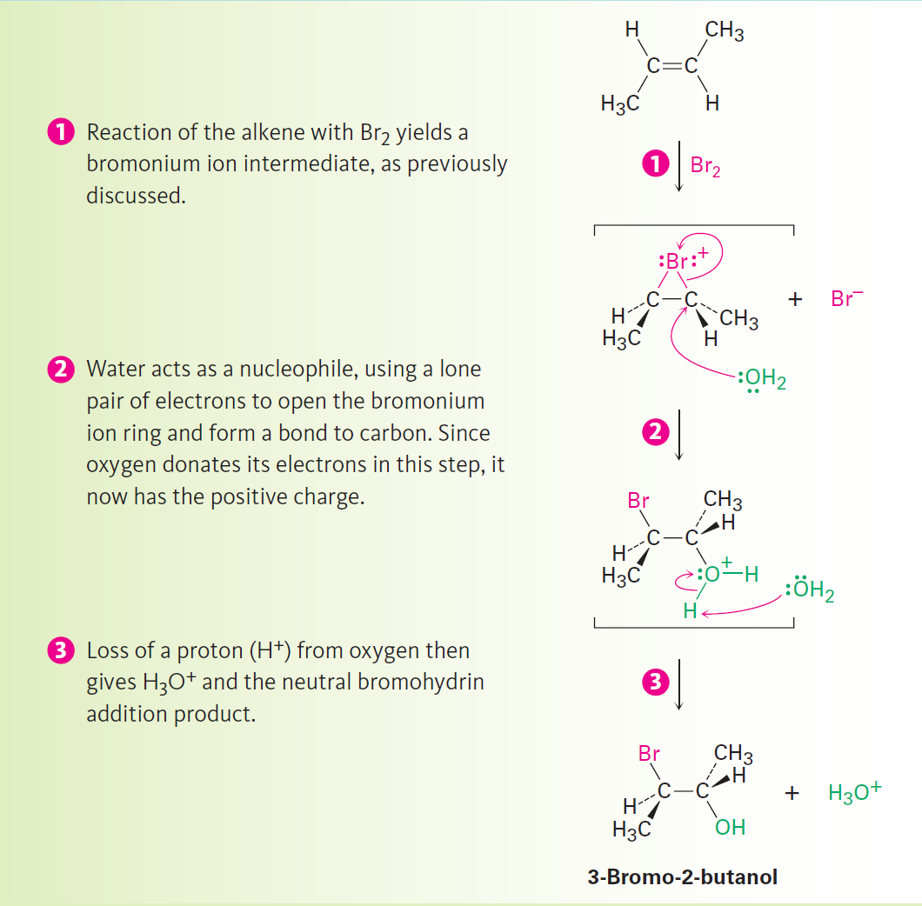
Figure 8.1 - Mechanism
Notes:
Halohydrins from Alkenes: Addition of HOX

Slide 19
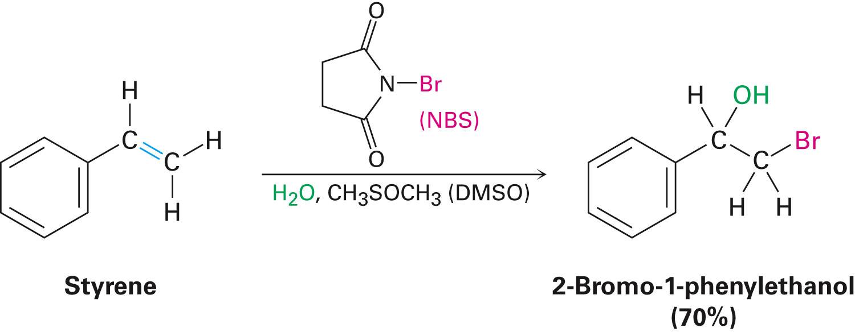
Halohydrins from Alkenes: Addition of HOX
Bromohydrin formation is carried out in a solvent such as aqueous dimethyl sulfoxide, CH₃SOCH₃ (DMSO), using the reagent N-bromosuccinimide (NBS)
Produces bromine in organic solvents and is a safer source
Notes:
Halohydrins from Alkenes: Addition of HOX

Slide 20
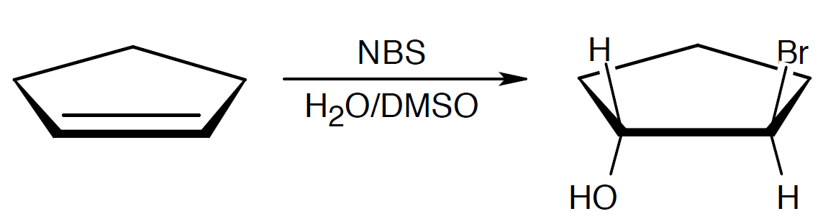
Worked Example
What product would you expect from the reaction of cyclopentene with NBS and water?
Show the stereochemistry
Solution:
–Br and –OH are trans in the product
Notes:
Halohydrins from Alkenes: Addition of HOX

Slide 21
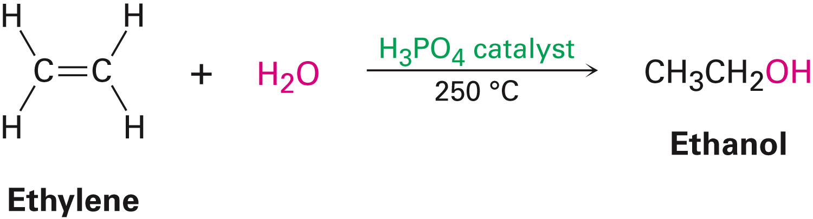
Hydration of Alkenes: Addition of H₂O by Oxymercuration
Hydration of an alkene is the addition of H₂O to give an alcohol
Reaction takes place on treatment of the alkene with water and a strong acid catalyst
Notes:
Hydration of Alkenes: Addition of H₂O by oxymercuration

Slide 22
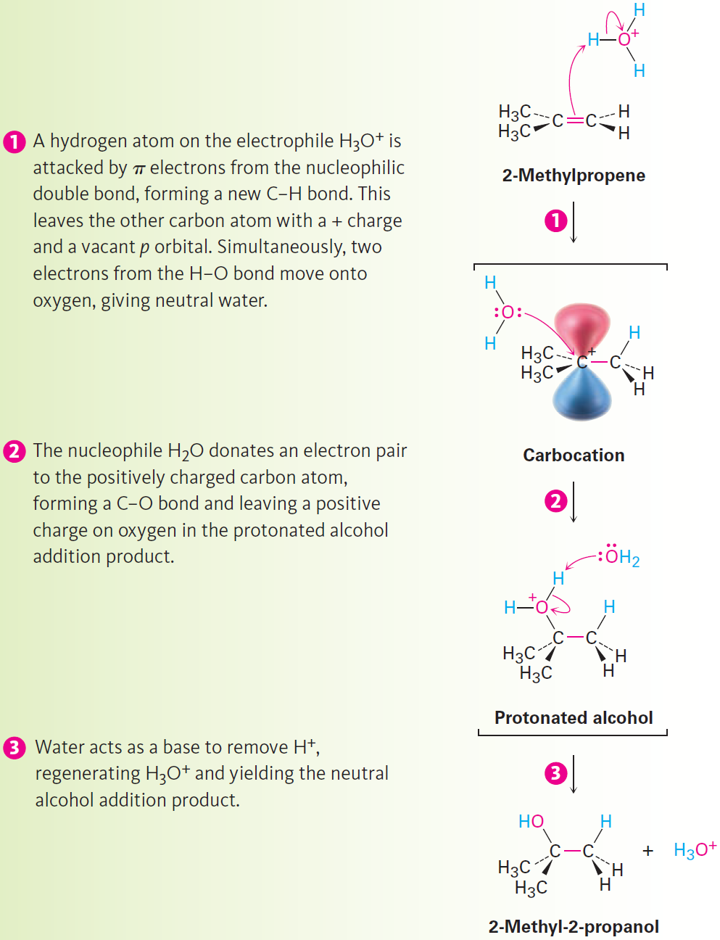
Figure 8.2 - Mechanism
Notes:
Hydration of Alkenes: Addition of H₂O by oxymercuration

Slide 23
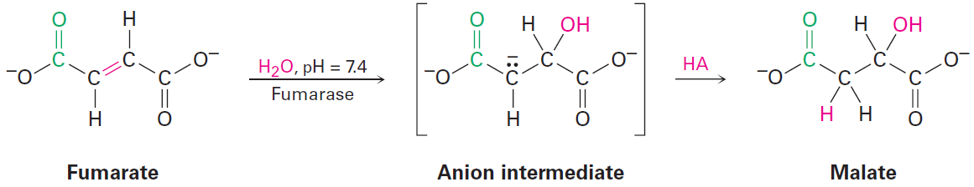
Hydration of Alkenes: Addition of H₂O by Oxymercuration
Acid-catalyzed hydration of isolated double bonds is uncommon in biological pathways
Fumarate is hydrated to give malate as one step in the citric acid cycle of food metabolism
In the laboratory, alkenes are often hydrated by the oxymercuration–demercuration procedure
Notes:
Hydration of Alkenes: Addition of H₂O by oxymercuration

Slide 24
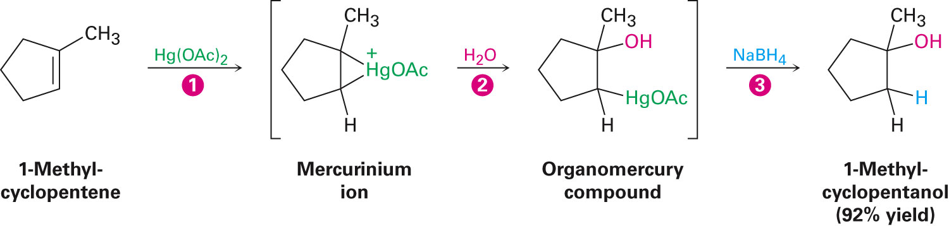
Oxymercuration Intermediates
Reaction is initiated by electrophilic addition of Hg²⁺ ion to the alkene
Gives an intermediate mercurinium ion
Regiochemistry of the reaction corresponds to Markovnikov addition of H₂O
Notes:
Hydration of Alkenes: Addition of H₂O by oxymercuration

Slide 25
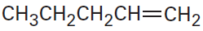
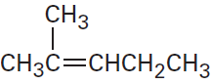
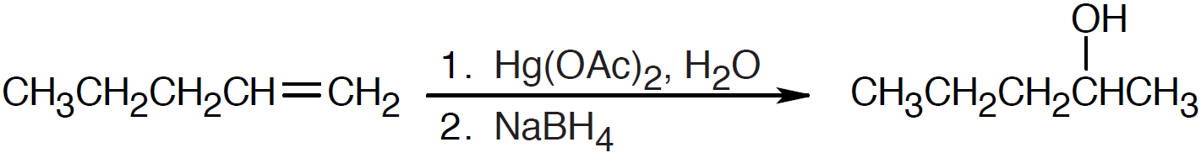
Worked Examples
What products would you expect from oxymercuration–demercuration of the following alkenes?
a)
b)
Solution:
Oxymercuration is equivalent to Markovnikov addition of H₂O to an alkene
a)
Notes:
Hydration of Alkenes: Addition of H₂O by oxymercuration

Slide 26
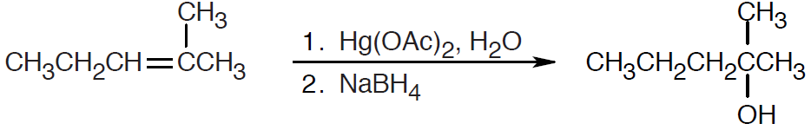
Worked Examples
b)
Notes:
Hydration of Alkenes: Addition of H₂O by oxymercuration

Slide 27
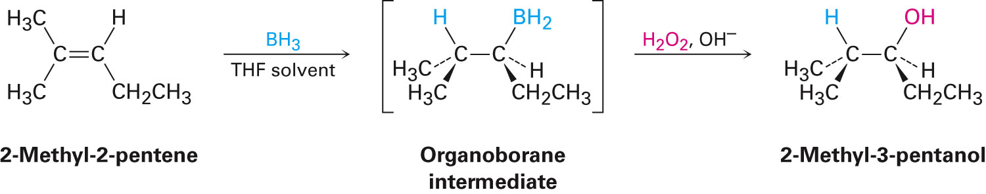
Hydration of Alkenes: Addition of H₂O by Hydroboration
Hydroboration: Process involving addition of a B–H bond of borane, BH₃, to an alkene to yield an organoborane intermediate, RBH₂
Boron has six atoms in its valance shell making borane a very reactive Lewis acid
Notes:
Hydration of Alkenes: Addition of H₂O by hydroboration

Slide 28
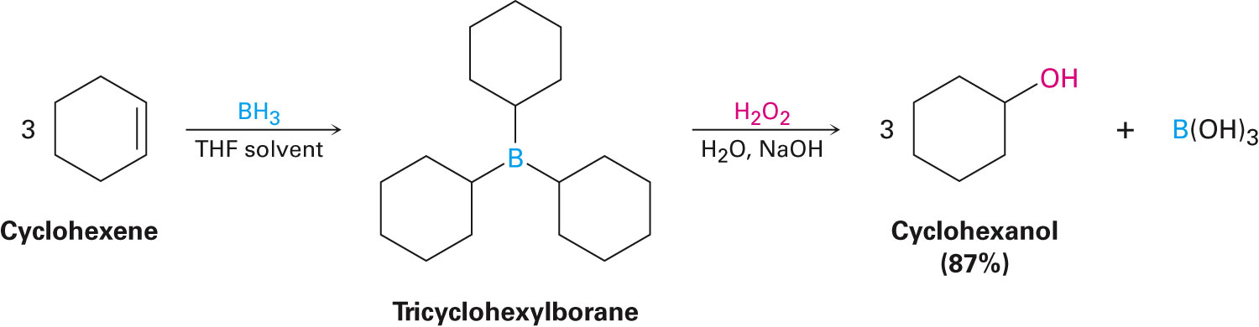
Hydration of Alkenes: Addition of H₂O by Hydroboration
Alkene reacts with BH₃ in THF solution, rapid addition to the double bond occurs three times and a trialkylborane is formed
Net effect of the two-step hydroboration–oxidation sequence is hydration of the alkene double bond
Notes:
Hydration of Alkenes: Addition of H₂O by hydroboration

Slide 29
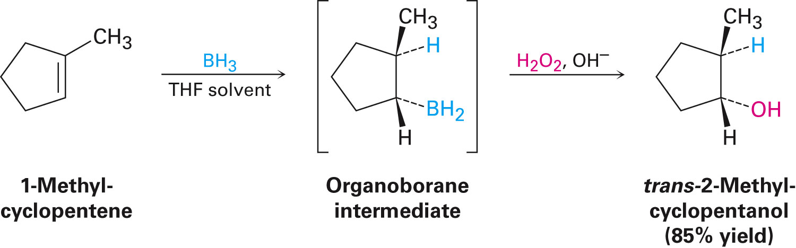
Hydration of Alkenes: Addition of H₂O by Hydroboration
Regiochemistry that results when an unsymmetrical alkene is hydroborated makes the hydroboration reaction very useful
During hydroboration–oxidation of 1-methylcyclopentene, boron and hydrogen add to the alkene from the same face of the double bond with syn stereochemistry
Notes:
Hydration of Alkenes: Addition of H₂O by hydroboration

Slide 30
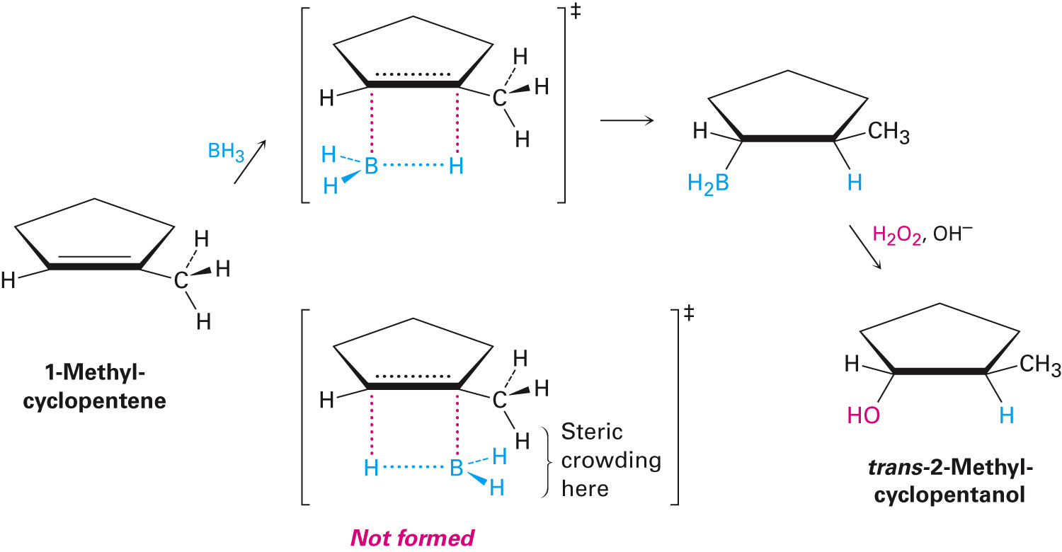
Hydroboration
Differs from other alkene addition reactions
Occurs in a single step without a carbocation intermediate
Attachment of boron is favored
Non-Markovnikov regiochemistry occurs
Notes:
Hydration of Alkenes: Addition of H₂O by hydroboration

Slide 31
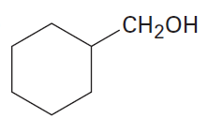
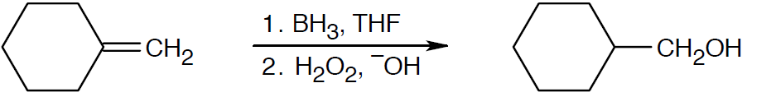
Worked Example
What alkene might be used to prepare the following alcohol by hydroboration–oxidation?
Solution:
The products result from hydroboration/oxidation of a double bond
The –OH group is bonded to the less substituted carbon of the double bond in the starting material
Notes:
Hydration of Alkenes: Addition of H₂O by hydroboration

Slide 32
Reduction of Alkenes: Hydrogenation
Hydrogenated: Addition of hydrogen to a double or triple bond to yield a saturated product
Reduction: Reaction that results in gain of electron density for carbon caused either by:
Formation between carbon and a less electronegative atom
Bond-breaking between carbon and a more electronegative atom
Notes:
Reduction of Alkenes: Hydrogenation

Slide 33
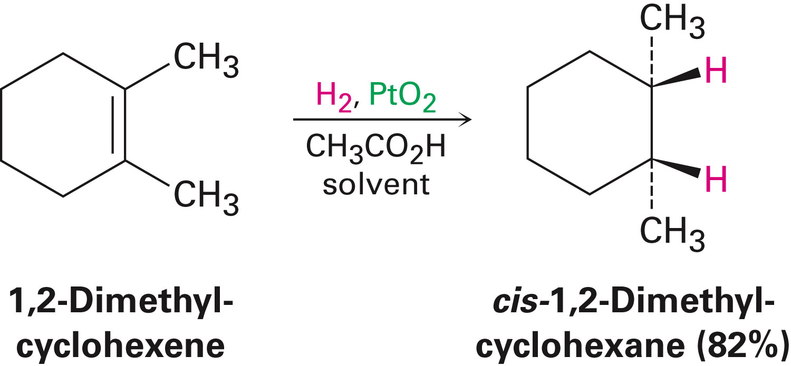
Reduction of Alkenes: Hydrogenation
Usually occurs with syn stereochemistry
H₂ is adsorbed onto the catalyst surface
Notes:
Reduction of Alkenes: Hydrogenation

Slide 34
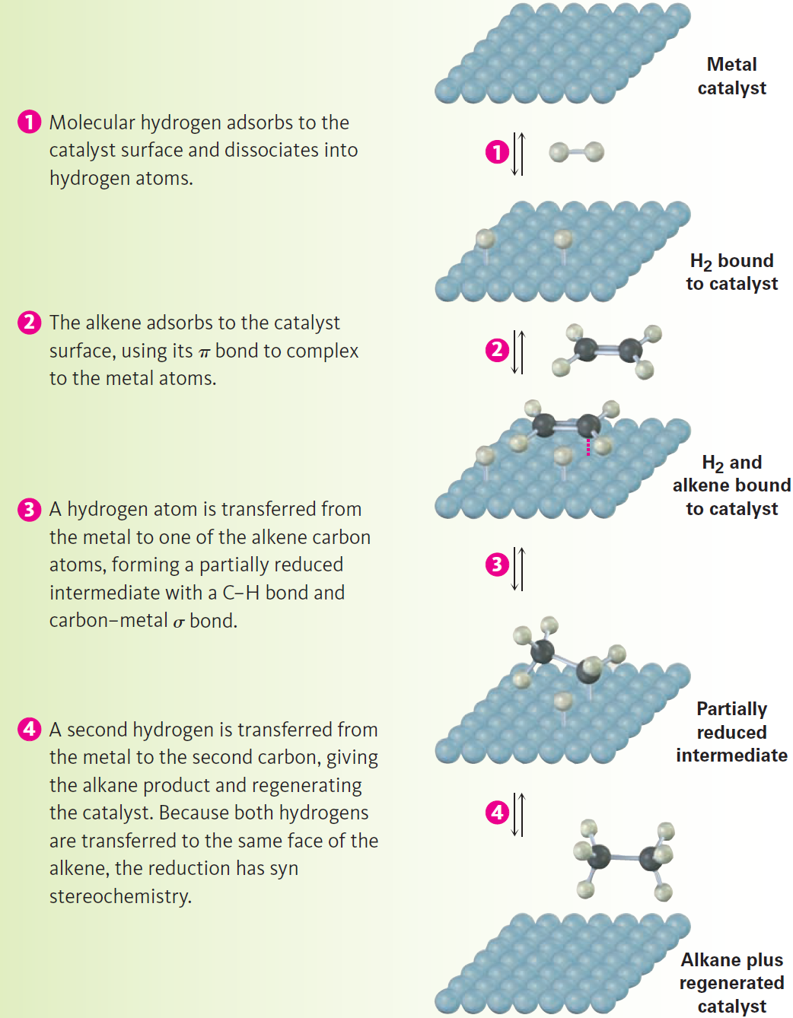
Figure 8.5 - Mechanism
Notes:
Reduction of Alkenes: Hydrogenation

Slide 35
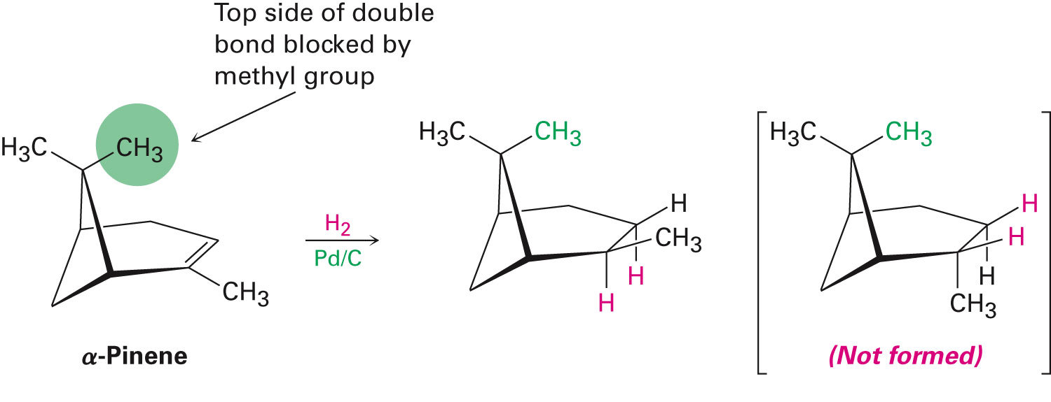
Reduction of Alkenes: Hydrogenation
Catalytic hydrogenation is extremely sensitive to the steric environment around the double bond
In α-pinene reduction occurs exclusively from the bottom face
Notes:
Reduction of Alkenes: Hydrogenation

Slide 36
Reduction of Alkenes: Hydrogenation
Catalytic hydrogenation is important in the food industry
Incomplete hydrogenation results in partial cis–trans isomerization of a remaining double bond
In biological hydrations, biological reductions occur in two steps:
Reducing agent, NADPH, adds a hydride ion to the double bond to give an anion
Anion is protonated by acid HA, leading to overall addition of H₂
Notes:
Reduction of Alkenes: Hydrogenation

Slide 37
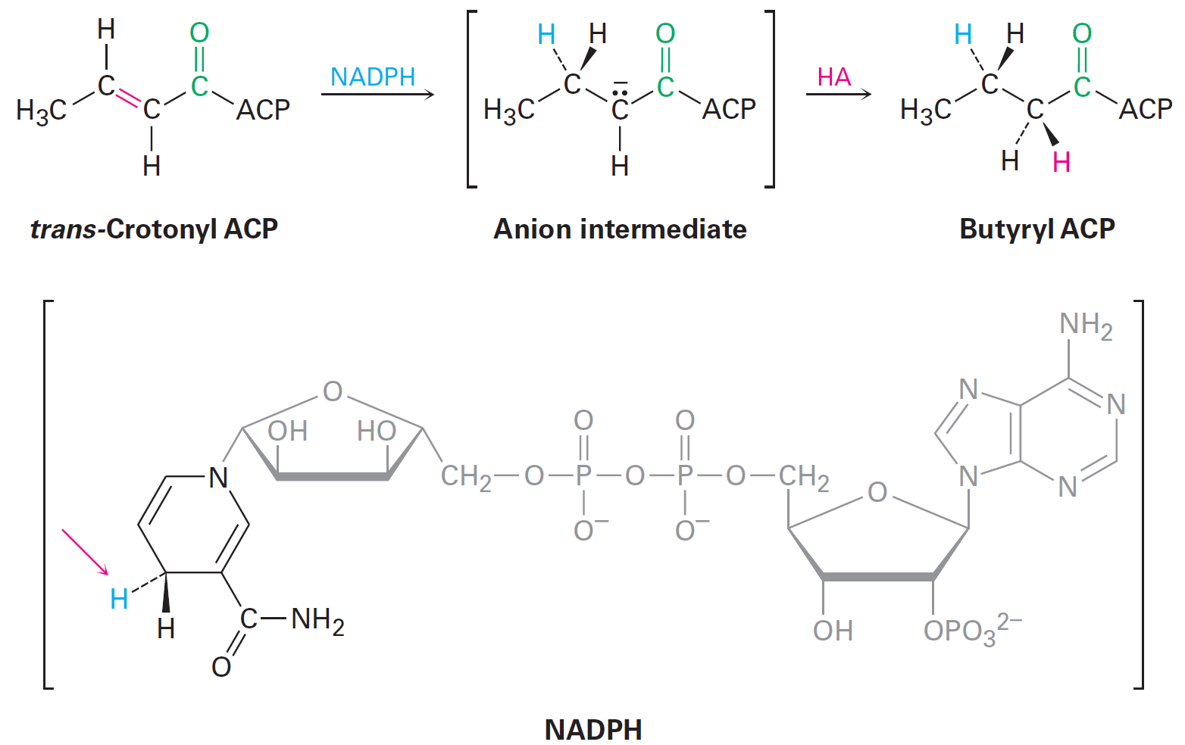
Figure 8.7 - Reduction of the Carbon–Carbon Double Bond in Trans-crotonyl ACP
Notes:
Reduction of Alkenes: Hydrogenation

Slide 38
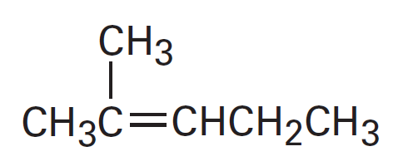
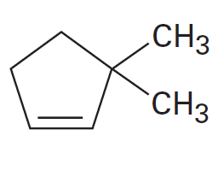
Worked Example
What products are obtained from catalytic hydrogenation of the following alkenes?
a)
b)
Notes:
Reduction of Alkenes: Hydrogenation

Slide 39
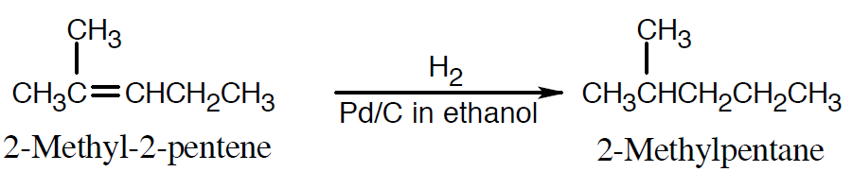
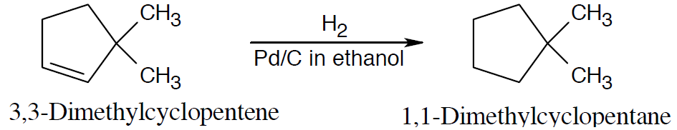
Worked Example
Solution:
a)
b)
Notes:
Reduction of Alkenes: Hydrogenation

Slide 40
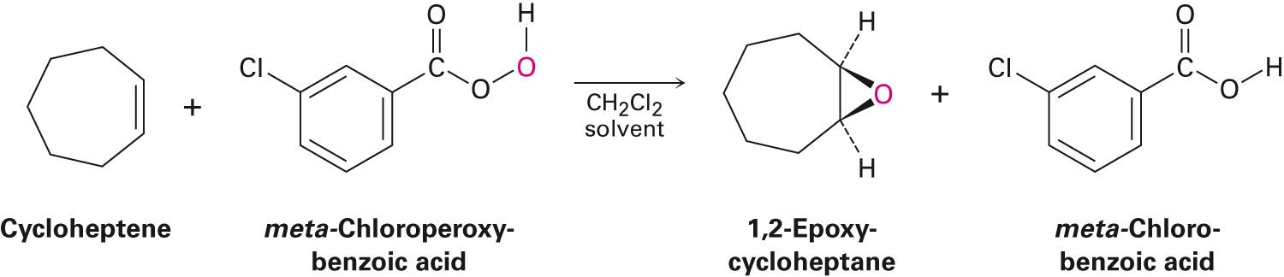
Oxidation of Alkenes: Epoxidation and Hydroxylation
Oxidation: Reaction that results in a loss of electron density for carbon by:
Bond formation between carbon and a more electronegative atom
Bond-breaking between carbon and a less electronegative atom
Alkenes oxidize to give epoxides on treatment with a peroxyacid, RCO₃H
Epoxide: Cyclic ether with an oxygen atom in a three-membered ring
Notes:
Oxidation of Alkenes: Epoxidation and hydroxylation

Slide 41
Oxidation of Alkenes: Epoxidation and Hydroxylation
Peroxyacids transfer an oxygen atom to the alkene with syn stereochemistry
Treating a base with halohydrin leads to elimination of HX and production of an epoxide
Epoxides undergo an acid-catalyzed ring-opening reaction with water
Gives corresponding 1,2-dialcohol, or diol, also called a glycol
Net result of the two-step alkene epoxidation/hydrolysis is hydroxylation
Notes:
Oxidation of Alkenes: Epoxidation and hydroxylation

Slide 42
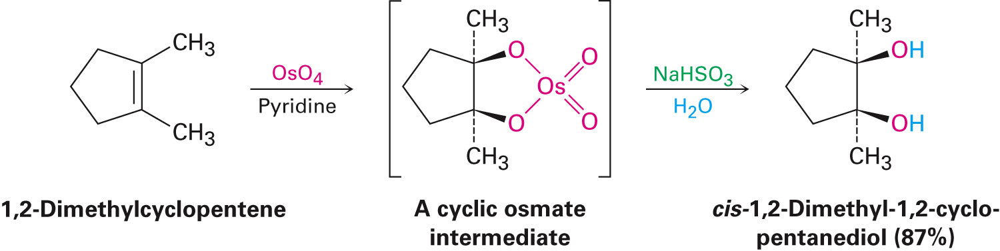
Oxidation of Alkenes: Epoxidation and Hydroxylation
Hydroxylation can be carried out directly by treating an alkene with osmium tetroxide
Reaction occurs with syn stereochemistry
Does not involve a carbocation intermediate
Notes:
Oxidation of Alkenes: Epoxidation and hydroxylation

Slide 43
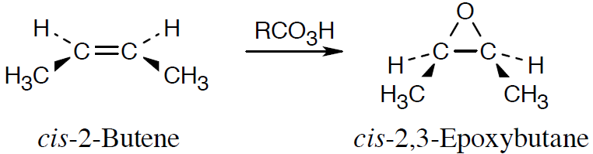
Worked Example
What product is expected from reaction of cis-2-butene with metachloroperoxybenzoic acid?
Show the stereochemistry
Solution:
Epoxidation using m-chloroperoxybenzoic acid is a syn addition
Original bond stereochemistry is retained
The methyl groups are cis
Notes:
Oxidation of Alkenes: Epoxidation and hydroxylation

Slide 44
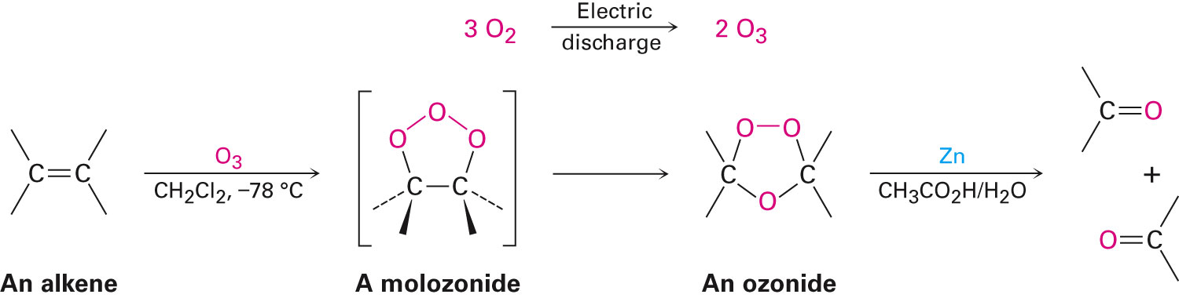
Oxidation of Alkenes: Cleavage to Carbonyl Compounds
Ozone (O₃) adds to C═C bond, at low temperature, to form molozonide
Molozonide rearranges to form ozonide
Notes:
Oxidation of Alkenes: Cleavage to carbonyl compounds

Slide 45
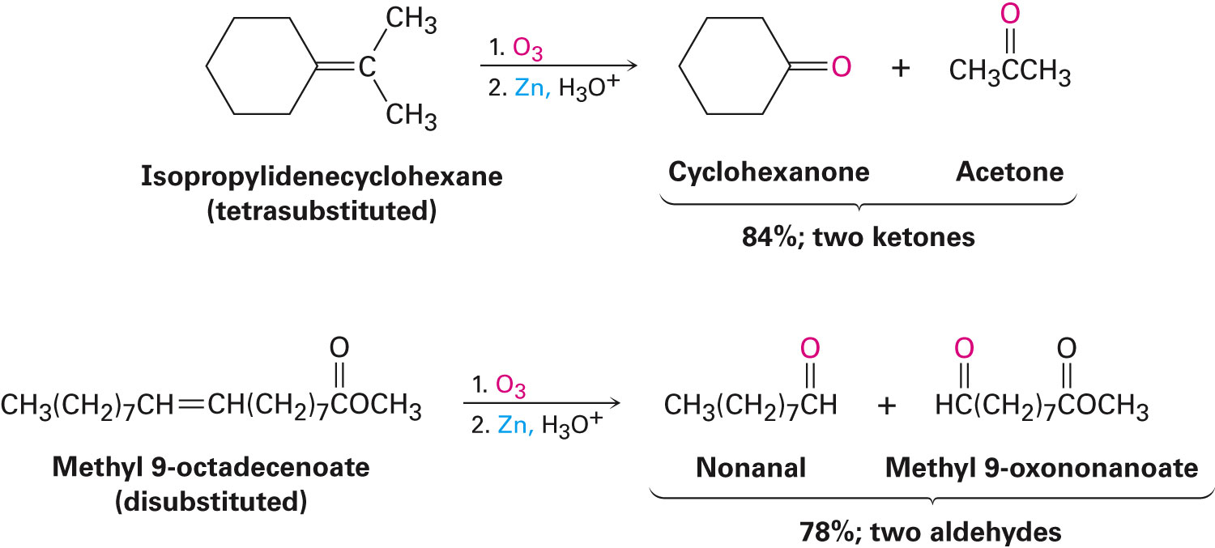
Oxidation of Alkenes: Cleavage to Carbonyl Compounds
Ozonide is treated with a reducing agent to produce carbonyl compounds
Notes:
Oxidation of Alkenes: Cleavage to carbonyl compounds

Slide 46
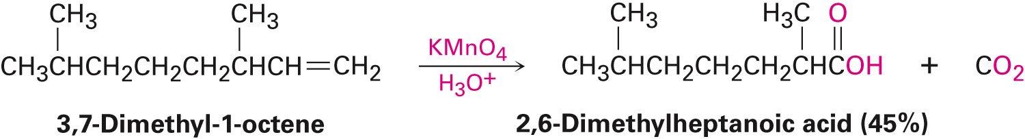
Oxidation of Alkenes: Cleavage to Carbonyl Compounds
Oxidizing reagents other than ozone cause double-bond cleavage
Potassium permanganate (KMnO₄) can produce carboxylic acids and carbon dioxide if hydrogens are present on C═C
Notes:
Oxidation of Alkenes: Cleavage to carbonyl compounds

Slide 47
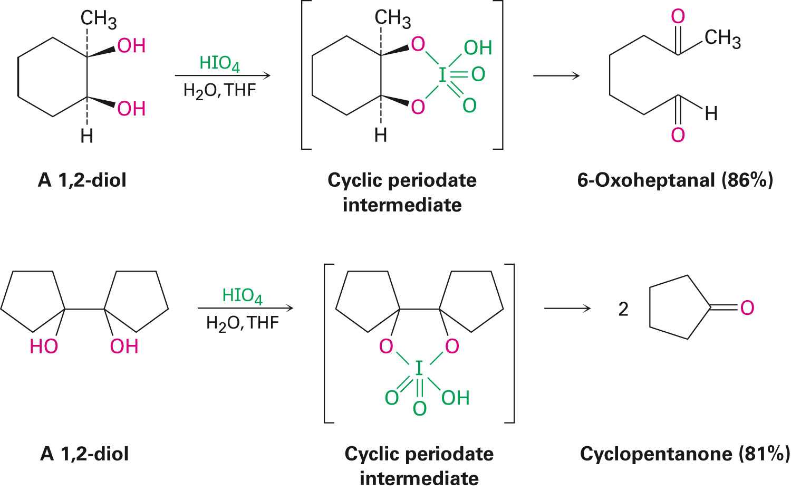
Oxidation of Alkenes: Cleavage to Carbonyl Compounds
Alkenes can be cleaved by hydroxylation to a 1,2-diol followed by reaction of a 1,2-diol with the periodic acid, HIO₄
Notes:
Oxidation of Alkenes: Cleavage to carbonyl compounds

Slide 48
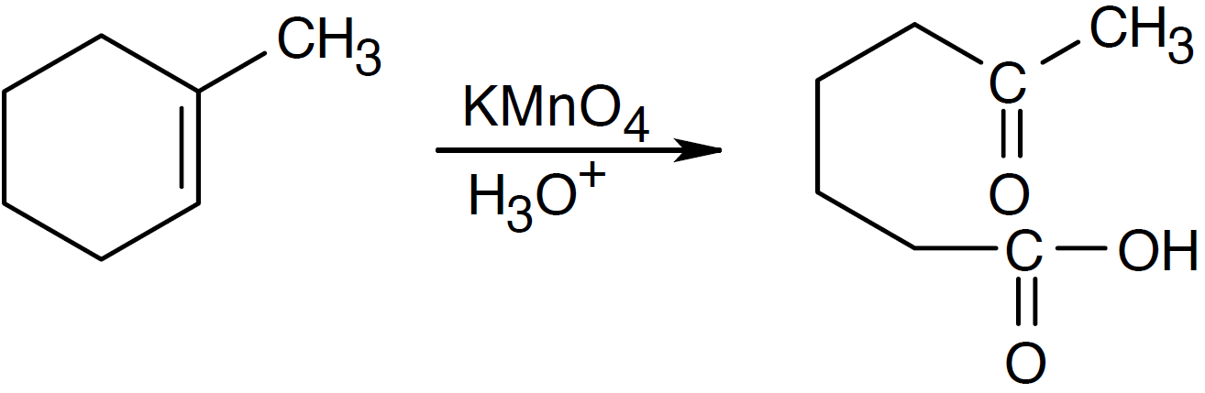
Worked Example
What products would be expected from reaction of 1-methylcyclohexene with aqueous acidic KMnO₄?
Solution:
Aqueous KMnO₄ produces:
A carboxylic acid from a C═C
A ketone from a double bond carbon that is disubstituted
Notes:
Oxidation of Alkenes: Cleavage to carbonyl compounds

Slide 49
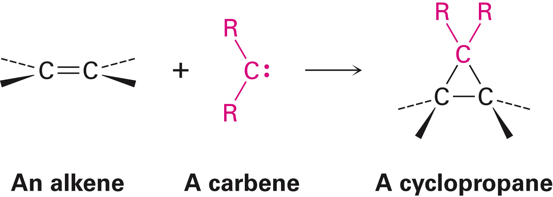
Addition of Carbenes to Alkenes: Cyclopropane Synthesis
Carbene, R₂C: Neutral molecule containing a divalent carbon with only six electrons in its valence shell
Alkene addition is the reaction with a carbine to yield a cyclopropane
Added symmetrically across double bonds to form cyclopropanes
Notes:
Addition of Carbenes to Alkenes: Cyclopropane synthesis

Slide 50
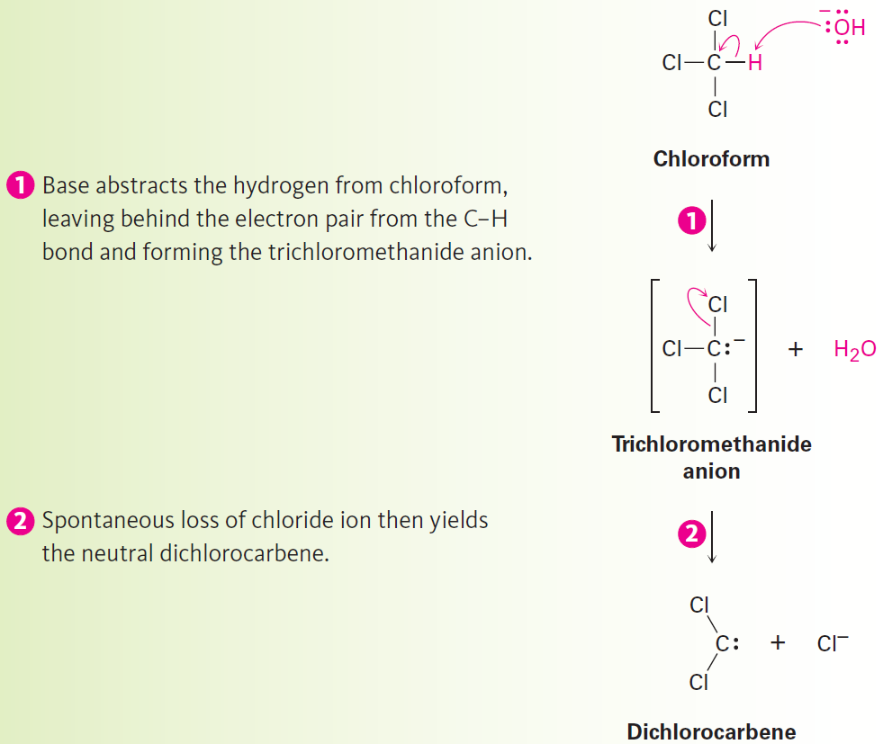
Figure 8.8 - Mechanism
Notes:
Addition of Carbenes to Alkenes: Cyclopropane synthesis

Slide 51
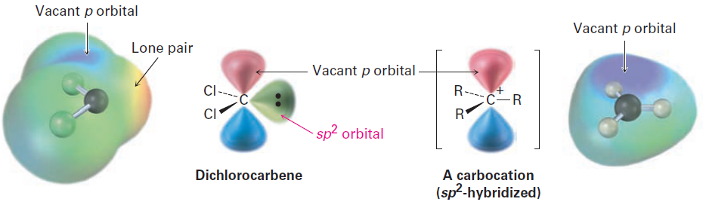
Figure 8.9 - The Structure of Dichlorocarbene
Notes:
Addition of Carbenes to Alkenes: Cyclopropane synthesis

Slide 52
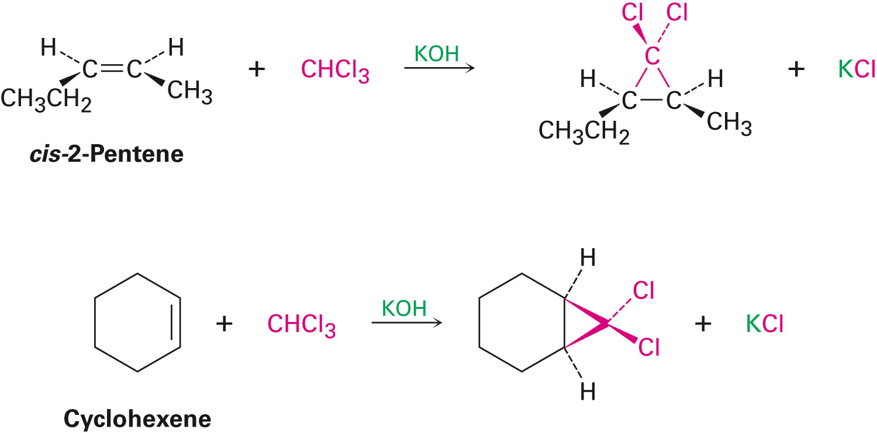
Addition of Carbenes to Alkenes: Cyclopropane Synthesis
Addition of dichlorocarbene with cis-2-pentene is stereospecific
Stereospecific: Only a single stereoisomer is formed as product
Notes:
Addition of Carbenes to Alkenes: Cyclopropane synthesis

Slide 53

Simmons-Smith Reaction
Method for preparing nonhalogenated cyclopropanes
Does not involve a free carbene
Utilizes a carbenoid
Reaction of diiodomethane with zinc-copper alloy produces zinc iodide
Yields corresponding cyclopropane in the presence of an alkene
Notes:
Addition of Carbenes to Alkenes: Cyclopropane synthesis

Slide 54


Worked Example
What product is expected from the following reaction
Solution:
Reaction of a double bond with CH₂I₂ yields a product with a cyclopropane ring that has a –CH2– group
Two different isomers can be formed, depending on stereochemistry of the double bond
Notes:
Addition of Carbenes to Alkenes: Cyclopropane synthesis

Slide 55

Radical Additions to Alkenes: Chain-Growth Polymers
Polymer: Large molecule consisting of repeating units of simpler molecules, called monomers
Formed by polymerization
Alkenes react with radical catalysts to undergo radical polymerization
Simple alkene polymers are called chaingrowth polymers
Notes:
Radical additions to alkenes: Chain-growth polymers

Slide 56


Radical Additions to Alkenes: Chain-Growth Polymers
Notes:
Radical additions to Alkenes: Chain-growth polymers

Slide 57

Radical Additions to Alkenes: Chain-Growth Polymers
Initiation
Few radicals are generated on heating a small amount of benzoyl peroxide catalyst
Benzoyloxy radical loses CO₂ and gives a phenyl radical
Notes:
Radical additions to Alkenes: Chain-growth polymers

Slide 58


Radical Additions to Alkenes: Chain-Growth Polymers
Propagation
Radical from initiation adds to alkene to generate alkene derived radical
Process repeats to form the polymer chain
Termination
Chain propagation ends when two radical chains combine
Notes:
Radical additions to Alkenes: Chain-growth polymers

Slide 59

Radical Additions to Alkenes: Chain-Growth Polymers
Other alkenes give other common polymers

Slide 60

Table 8.1 - Some Alkene Polymers and Their Uses
Notes:
Radical additions to Alkenes: Chain-growth polymers

Slide 61

Worked Example
Show the monomer units required to prepare the following polymer:
Solution:
The smallest repeating unit in each polymer is identified and double bond is added
Monomer
H₂C═CHOCH₃
Notes:
Biological Additions of radicals to alkenes

Slide 62

Biological Additions of Radicals to Alkenes
Radical addition reactions have severe limitations in a laboratory environment
More controlled and more common than laboratory or industrial radical reactions
Notes:
Biological Additions of radicals to alkenes

Slide 63

Figure 8.10 - Pathway of Biosynthesis of Prostaglandins from Arachidonic Acid
Notes:
Biological Additions of radicals to alkenes

Slide 64

Reaction Stereochemistry: Addition of H₂O to an Achiral Alkene
Majority of biochemical reactions yield products with chirality centers
1-Butene yields an intermediate secondary carbocation by protonation
It reacts with H₂O from either the top or the bottom
The two transition states are mirror images
Notes:
Reaction Stereochemistry: Addition of H₂O to an achiral alkene

Slide 65

Figure 8.11 - Reaction of H₂O with the Carbocation Resulting from Protonation of 1-Butene
Notes:
Reaction Stereochemistry: Addition of H₂O to an achiral alkene

Slide 66

Reaction Stereochemistry: Addition of H₂O to an Achiral Alkene
Formation of a new chirality center by achiral reactants leads to a racemic mixture of enantiomeric products
Optically active product can only result by starting with an optically active reactant or chiral environment
Cis-aconitate is achiral
Only the enantiomer of the product is formed
Notes:
Reaction Stereochemistry: Addition of H₂O to a achiral alkene

Slide 67
Reaction Stereochemistry: Addition of H₂O to a Chiral Alkene
The stereochemistry in acid-catalyzed addition of H₂O is established by reaction of H₂O with a carbocation intermediate
Does not contain a plane of symmetry
Chiral because of the chirality center at C4
Formation of a new chirality center by a chiral reactant leads to unequal amounts of diastereomeric products
Products are also optically active, if the chiral reactant is optically active because only one enantiomer is used
Notes:
Reaction Stereochemistry: Addition of H₂O to a chiral alkene

Slide 68

Figure 8.12 - Stereochemistry of the Acid-Catalyzed Addition of H₂O to the Chiral Alkene
Notes:
Reaction Stereochemistry: Addition of H₂O to a chiral alkene

Slide 69

Worked Example
What products are formed from hydration of 4-methylcyclopentene?
Solution:
Notes:
Reaction Stereochemistry: Addition of H₂O to a chiral alkene

Slide 70
Summary
Bromine and chlorine add to alkenes via three-membered-ring bromonium ion or chloronium ion intermediates to give addition products having anti stereochemistry
If water is present during the halogen addition reaction, a halohydrin is formed
Oxymercuration–demercuration involves electrophilic addition of Hg²⁺ to an alkene followed by subsequent treatment of the cation intermediate with NaBH₄

Slide 71
Summary
Hydroboration involves addition of borane followed by oxidation of the intermediate organoborane with alkaline H₂O₂
Hydroboration–oxidation gives the product with non-Markovnikov syn stereochemistry
Catalytic hydrogenation is a process in which alkenes are reduced by addition of H₂ in the presence of a catalyst
Alkenes are oxidized by reaction with a peroxyacid to give epoxides

Slide 72
Summary
The corresponding cis-1,2-diols can be made directly from alkenes by hydroxylation with OsO₄
Alkenes react with divalent substances called carbenes, to give cyclopropanes
Nonhalogenated cyclopropanes are best prepared by a process called the Simmons–Smith reaction
Alkene polymers are formed by chain-reaction polymerization of simple alkenes

